Slide 1
Predicting the energy output of wind turbine based on weather condition
IBM HACK CHALLENGE 2020

Slide 2
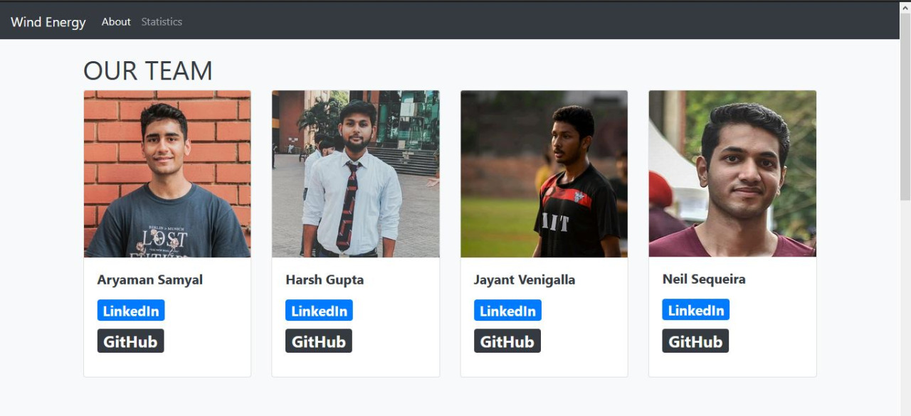
Project by
Team name : YUMIT
Project ID : SPS_PRO_1059
Application ID : SPS_CH_APL_20200002682

Slide 3
Work Contribution
Aryaman : Data Collection And Analysis , Model Development And Deployment.
Neil : Data Collection And Analysis , Model Development And Deployment.
Harsh : Github Configuration, Python Web Application Development
Jayant : Github Configuration, Python Web Application Development

Slide 4
INTRODUCTION
To tackle the problem of overproduction of electricity when combining renewable and traditional power sources, we have proposed an innovative and novel solution, applying an AI for time series forecasting and therefore predicting the power output of wind farms for the next 72 hours.
Using our unique, custom-designed website, the client will have access to a visual and graphical representation of the supply and demand statistics using which they can effectively collaborate with various energy sources to prevent overproduction and for better economic management.

Slide 5
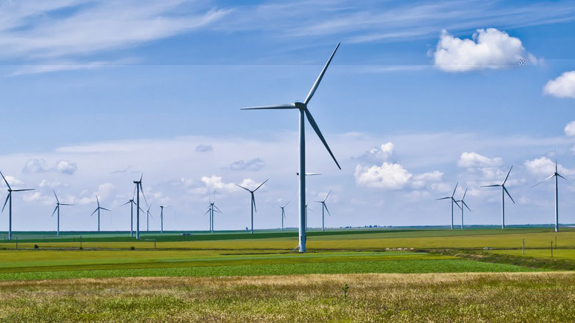
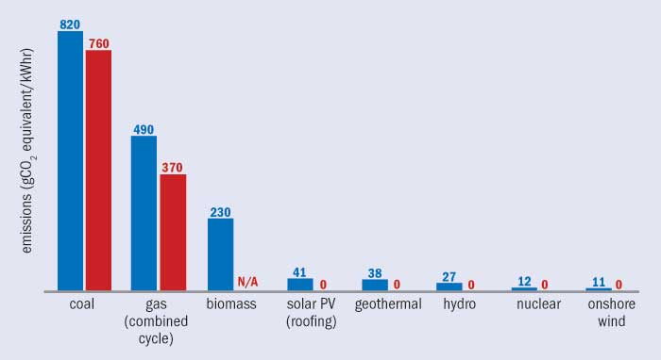
Environmental Impact
Wind turbines do not release emissions that can pollute the air or water (with rare exceptions), and they do not require water for cooling.
Wind turbines may also reduce the amount of electricity generation from fossil fuels, which results in lower total air pollution and carbon dioxide emissions.

Slide 6
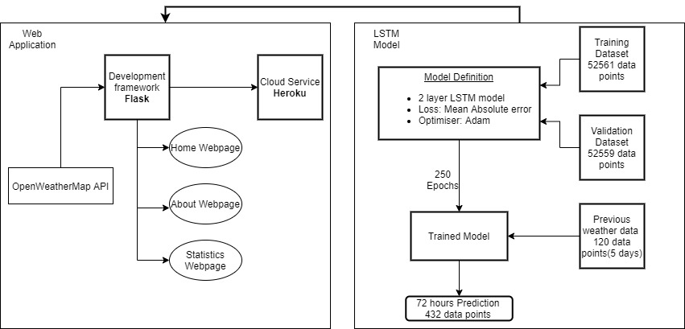
Workflow

Slide 7
Our Model
We have utilized a Long Short Term Memory (LSTM ) Model for predicting the power output of the wind turbines
Efficient for time series forecasting.
LSTM is very capable of handling data for long periods.
Selected "Adam" as our optimizer.
Loss function utilized is "Mean Absolute Error" .

Slide 8
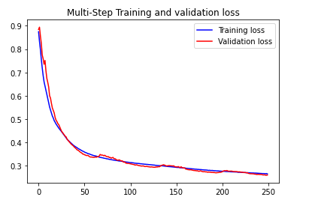
Software Design
Prediction Algorithm. The model is a sequential neural network employing two layers of LSTM and one layer of Dense. It consists of 14,960 trainable parameters.
Developed in Python using the Tensorflow framework and the Keras API.

Slide 9
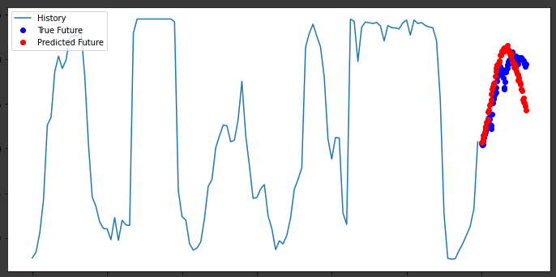
Experimental Results
Training results(250 epochs)

Slide 10
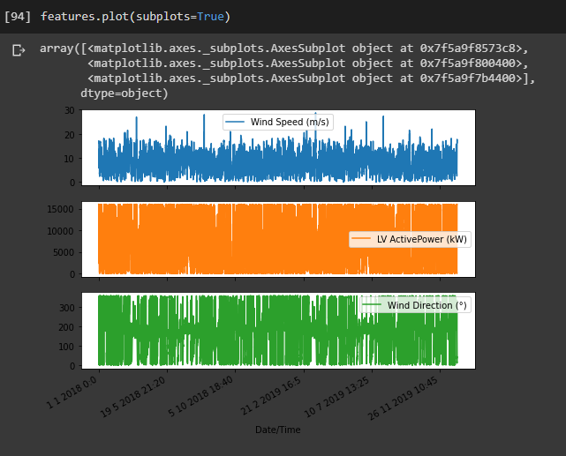
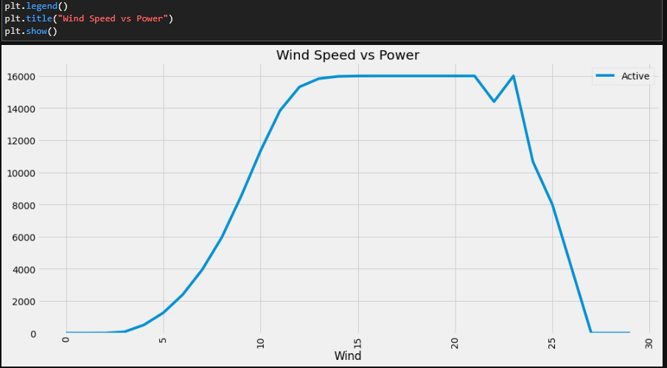
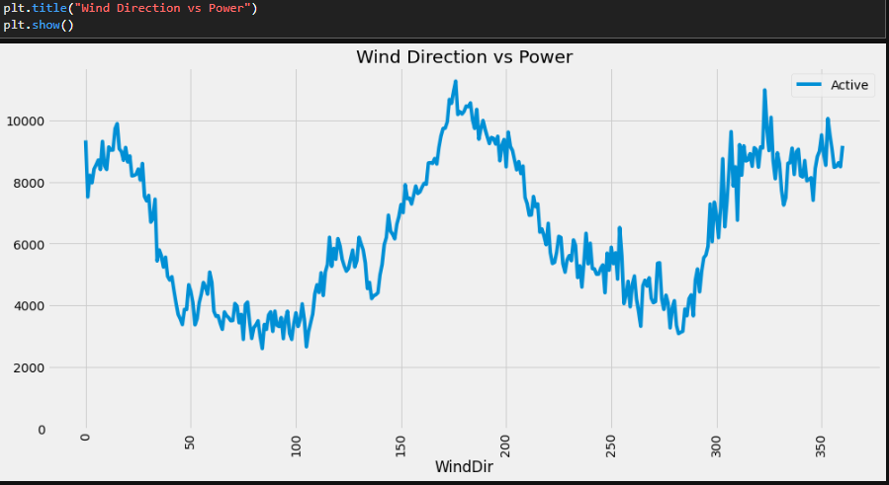
Neural Network Model Outputs Visualisation

Slide 11
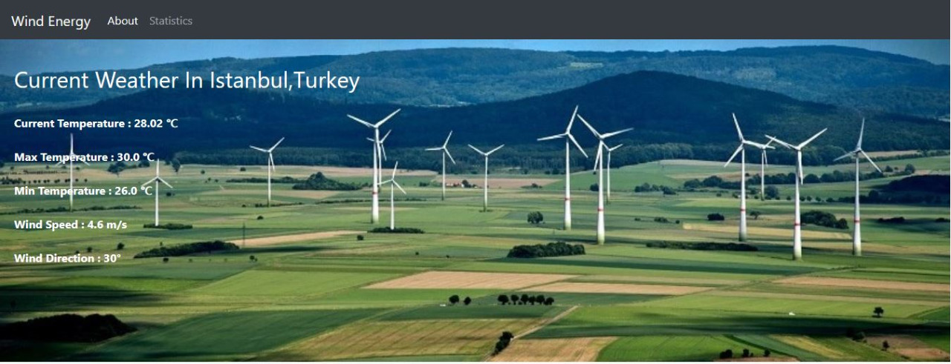
Web Application
Designed using Flask
Data acquisition through OpenWeatherMap API

Slide 12
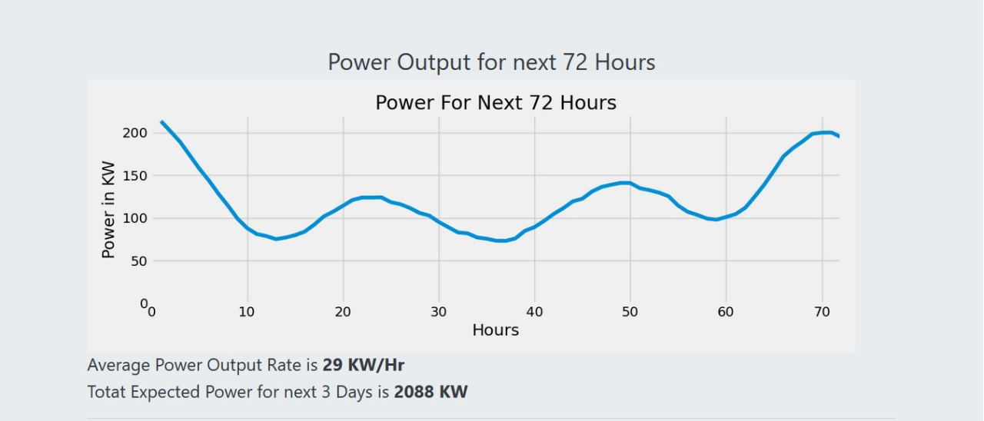
Model Integration with Web Application
The machine learning model is integrated into the application and automatically uses the data from the .csv file to predict the power output for the next 72 hours.
Furthermore, a line chart is plotted and displayed on the home page as well as the statistics page.

Slide 13
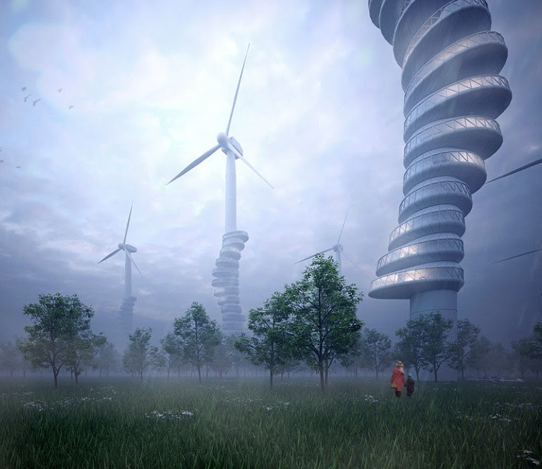
Future Scope
If deployed at an industrial scale, with an improvement in hardware, the accuracy of the model can be vastly improved by extensive experimentation
A system integrating multiple renewable sources of energy will disrupt the current global scenario of energy production and will enable humanity to take a vital step towards a better, green future.

Slide 14
THANK YOU FOR WATCHING
By Team Yumit

